Slide 1
Decision tree
Supervised learning
분류 트리분석
회기 트리분석
ID3, C4.5, C5.0
Classification And Regression Tree, CART
 | 알고리즘 | splitting
인공지능,기계학습 | ID3, C4.5, C5.0 | Entropy, inf gain
통계학 | CART | gini

Slide 2

학습법
입력 변수
목표 변수
predict
x1:성별, x2:나이, x3:가족 ….
Y: 사망여부

Slide 3
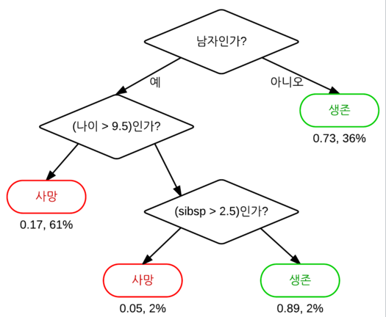
graph
Root node
internal node
leaf node, terminal node
Class label

Slide 4
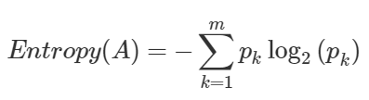
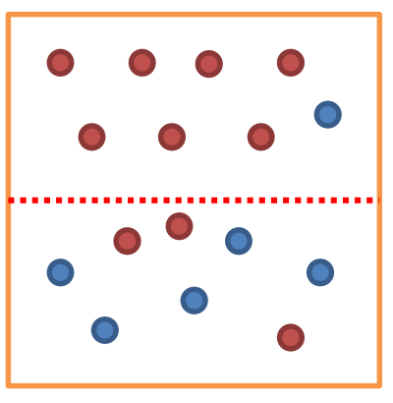

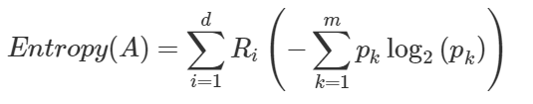
Entropy
A
before
Pk: 범주안에 속한 비율
after
Pk,Ri: 범주안에 속한 비율
Ep: 0 -> pure
Ep: 1 -> impure
Information gain:
Before entropy(A) – After entropy(A)
(choose attribute that results in greatest information gain)
->많은 attribute values를 가지는 attribution을 선호함
Splitting line

Slide 5
A criterion for attribute selection
The one which will result in the smallest tree
Heuristic: choose the arrtribute that produces the “purest” nodes
Choose the attribute that results in greates information gain
(다양한 속성값을 가지는 attribut선호)
Choose the arrtibute that results in greatest Gain Ratio

Slide 6
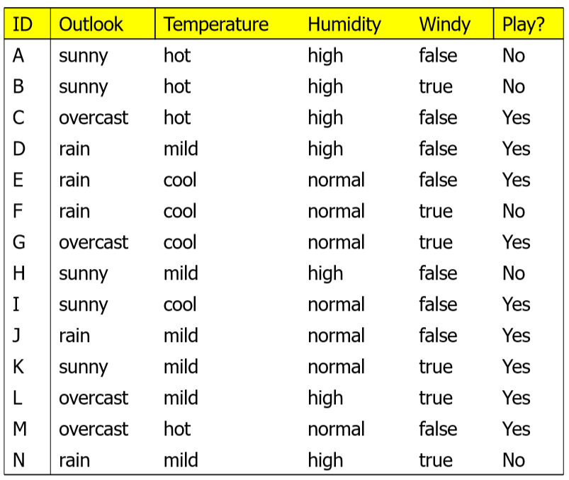
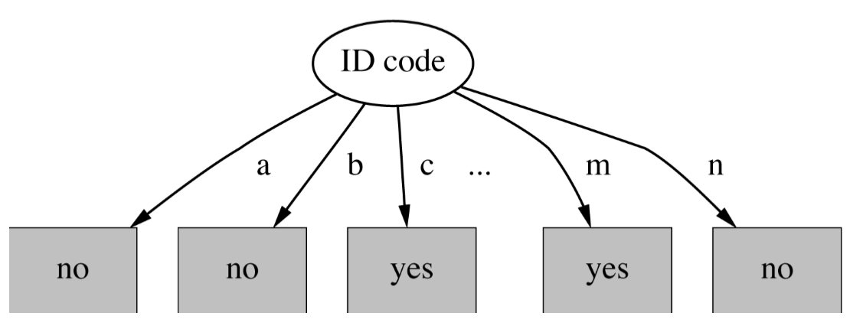
Gain ratio
High -branch
Each leaf node is Pure
Maximal Infromation gain
Gain ratio reduces its bias on high-branch attribute
(너무 과도한 information gain값을 가지는 attribute 를 약화시켜줌)

Slide 7
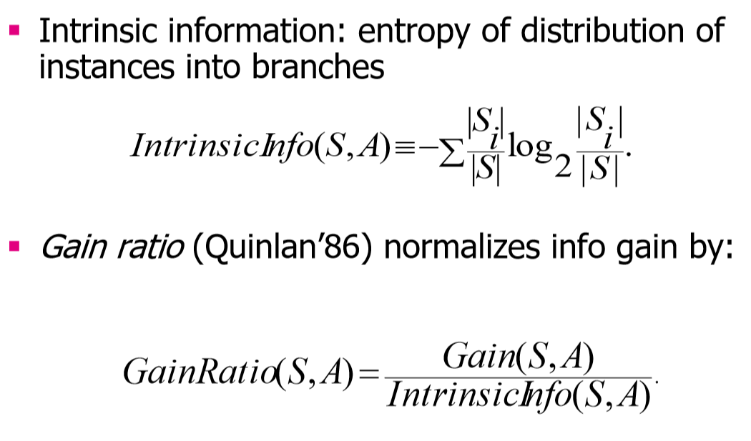
Gain ratio
Large when data is evenly spread
Small when all data belong to one branch
Data num of each branch
All data num

Slide 8
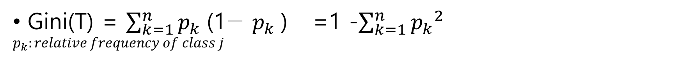
Gini
Split before
Gini(T) = $\sum_{k=1}^{n}{{p_{k} \text{(1−} p_{k} \text{)}}^{}}$ =1 -$\sum_{k=1}^{n}{{p_{k}}^{2}}$
$$p_{k}:relative frequency of class j$$
Split after
${Gini}_{split}\left(T\right)= \frac{N_{1}}{N}Gini\left(T_{1}\right)+$ $\frac{N_{2}}{N}Gini\left(T_{2}\right)$
smallest ${Gini}_{split}\left(T\right)$ is chosen to split the node

Slide 9
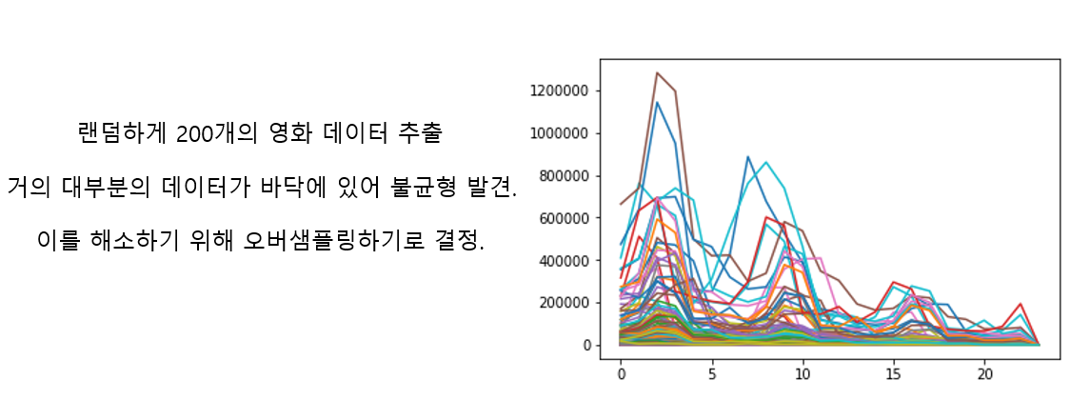
Bootstrap aggregating(bagging)
Avoid overfitting

Slide 10
Ensemble learning methods
Random forest
Boost tree
회전 포레스트

Slide 11
Random forest
임의 노드 최적화(randomized node optimization, RNO)와 배깅(bootstrap aggregating, bagging)을 결합한 방법과 같은 CART(classification and regression tree)를 사용
Robust to noise

Slide 12
Most often used algorithm
ID3 -> C4.5 -> C5.0

Slide 13
pruning

